Slide 1
Spam Email Classifier
Team Dev Hour:
Jerel Santos, Caden Silberlicht, Drew Price

Slide 2

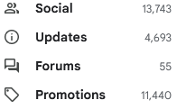
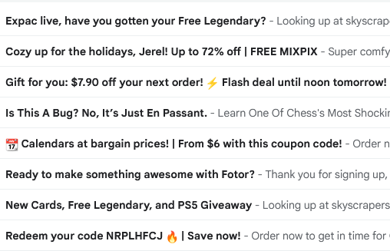
The Problem
Our emails are getting flooded
Spam detection already exists
Want to learn about the process behind spam detection
Learning more about data parsing and manipulation
Understanding Naive Bayes and why it can work with limited training and testing data

Slide 3
Solution Approach
Gather our own data, no premade datasets
More beneficial to our learning (working with API and learn how classifiers read data)
Use Google API to get emails from personal gmail accounts
Format emails to be read by classifier
Naive Bayes Classifier
Best training algorithm for our limited data size
Use evaluation loops to make our training more accurate
Formatting the testing and training data into calculations to be graphed

Slide 4
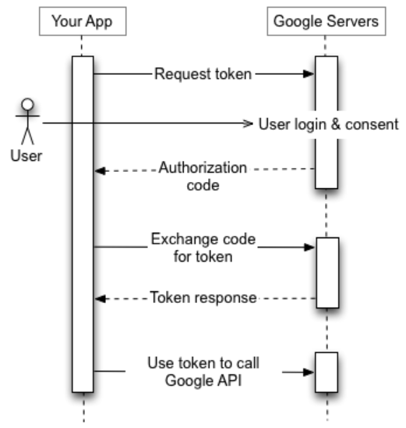
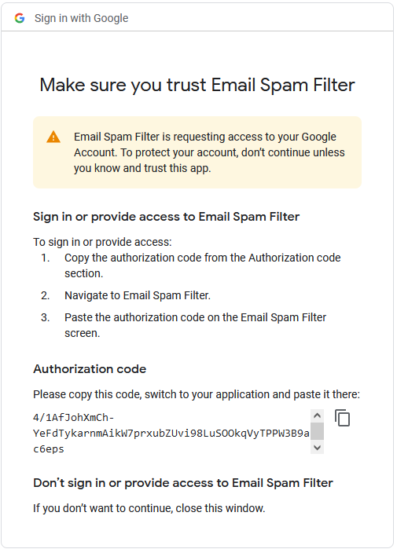
Google API
Get emails from our personal Gmail accounts
API’s workflow designed for webapps, not Colab notebooks
Had to revert to previous versions of google-auth to bypass this
Enter authorization code directly into console
Token response directly saved into Colab notebook
Token can be used to call API in future code blocks

Slide 5
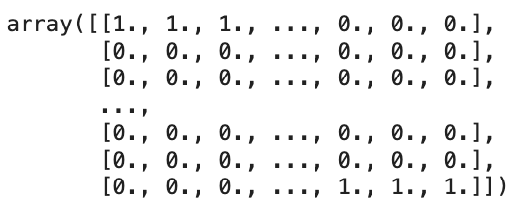
Formatting Emails
Spam is deleted after 30 days, limiting the amount of Spam to collect.
Limited amount to work with.
100 non-Spam
50 Spam
Tokenize text
Lowercase & keep only alphabetical
X = Bag-of-words approach
Y = 1 for Spam 0 for non-Spam

Slide 6
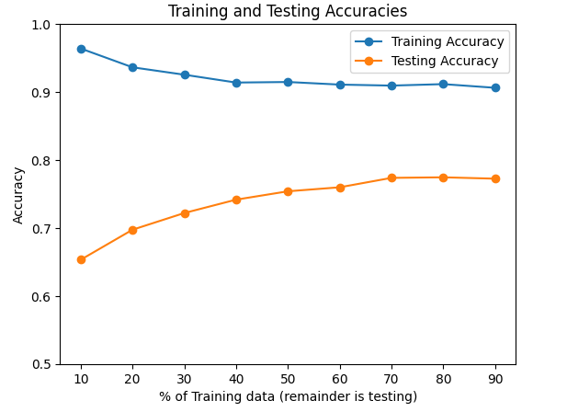
Naive Bayes Classifier
Acquire bag of words and split data into training and testing data
Train the model using Naive Bayes, iterating through the training n_evaluation times
Each n_evaluation goes through the training 100 times
After comparing our testing data to the predicted data from training, we plot our findings:

Slide 7
Conclusion
After completing this project, we learned all about the process of building a model and the complexity of data manipulation to fit the correct sizing for training eligibility.
One advancement we hope to make in the future is being able to train a model using one person’s email and test that model using a different person’s email.

